Slide 1
Proof improving refactoring
Francesco Logozzo, Microsoft Research, Redmond, WA
With P. Cousot, R. Cousot, M. Barnett, M. Fahndrich, S. Carr

Slide 2
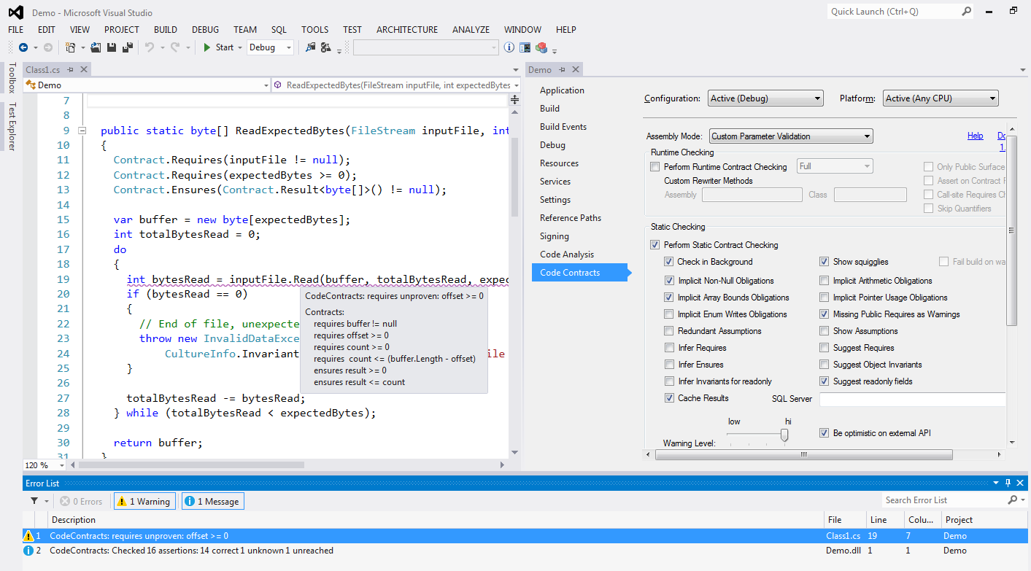
VS Integration
CodeContracts in
.NET 4.0
Test on steroids
Failed precondition
Used internally at MSFT
> 120K external downloads
Compile-time verification

Slide 3
How I found myself doing refactoring….

Slide 4
Extract method with contracts
public int Decrement(int x)
{
Contract.Requires(x >= 5);
Contract.Ensures(Contract.Result<int>() >= 0);
while (x != 0) x--;
return x;
}
public int Decrement(int x)
{
Contract.Requires(x >= 5);
Contract.Ensures(Contract.Result<int>() >= 0);
x = NewMethod(x);
return x;
}
private static int NewMethod(int x)
{
while (x != 0) x--;
return x;
}

Slide 5
and the (modular) proof?
public int Decrement(int x)
{
Contract.Requires(x >= 5);
Contract.Ensures(Contract.Result<int>() >= 0);
while (x != 0) x--;
return x;
}
public int Decrement(int x)
{
Contract.Requires(x >= 5);
Contract.Ensures(Contract.Result<int>() >= 0);
x = NewMethod(x);
return x;
}
private static int NewMethod(int x)
{
while (x != 0) x--;
return x;
}
Postcondition: ok
Postcondition
Violation?
No overflow
Possible overflow
P. Cousot, R. Cousot, F. Logozzo, M. Barnett,
An Abstract Interpretation Framework for Refactoring, OOPSLA’12

Slide 6
Simple solutions?
Method inlining the reverse of extract method
May not scale up, how many levels should we inline?
Isolated analysis infer pre- and postconditions of the extracted method
Too imprecise, without the context inferred contracts may be too generic
Invariant projection project the pre/post-states on the parameters and return value
Too specific, cannot refactor unreached code
User assistance User provides the contracts
Impractical, too many contracts to write
State of the art (before our work ;-)

Slide 7
Requirement #1: Validity
The inferred contract should be valid
Counterexample:
public int Decrement(int x) { Contract.Requires(x >= 5); Contract.Ensures(Contract.Result<int>() >=0); x = NewMethod(x); return x; } | private static int NewMethod(int x) { Contract.Requires(x >= 5); Contract.Ensures(Contract.Result<int>()==12345); while (x != 0) x--; return x; }
ok
Invalid ensures

Slide 8
Requirement #2: Safety
The precondition of the extracted method should advertise possible errors
Counterexample:
public int Decrement(int x) { Contract.Requires(x >= 5); Contract.Ensures(Contract.Result<int>() >=0); x = NewMethod(x); return x; } | private static int NewMethod(int x) { Contract.Ensures(Contract.Result<int>() == 0); while (x != 0) x--; return x; }
ok
Possible overflow

Slide 9
Requirement #3: Completeness
The verification of the callee should still go through
Counterexample: Valid and safe contract, but not complete
public int Decrement(int x) { Contract.Requires(x >= 5); Contract.Ensures(Contract.Result<int>() >=0); x = NewMethod(x); return x; } | private static int NewMethod(int x) { Contract.Requires(x >= 5); Contract.Ensures(Contract.Result<int>() <= x); while (x != 0) x--; return x; }
Can’t prove ensures
ok

Slide 10
Requirement #4: Generality
The inferred contract is the most general satisfying Validity, Safety, and Completeness
Counterexample: Valid, Safe, Complete but not General contract
Requires too strong
public int Decrement(int x) { Contract.Requires(x >= 5); Contract.Ensures(Contract.Result<int>() >=0); x = NewMethod(x); return x; } | private static int NewMethod(int x) { Contract.Requires(x >= 5); Contract.Ensures(Contract.Result<int>() == 0); while (x != 0) x--; return x; }
ok
ok

Slide 11
Our solution
Valid, Safe, Complete, and General contract
public int Decrement(int x) { Contract.Requires(x >= 5); Contract.Ensures(Contract.Result<int>() >=0); x = NewMethod(x); return x; } | private static int NewMethod(int x) { Contract.Requires(x >= 0); Contract.Ensures(Contract.Result<int>() == 0); while (x != 0) x--; return x; }
ok
ok

Slide 12
Extract method with contracts
Demo at http://channel9.msdn.com/Events/Build/2013/3-403
From minute 38:30
Formalization in the OOPSLA’11 paper
Generalized Hoare Logic (Algebraic Hoare Logic) to formalize refactoring
Solution to the problem of extract method with contracts

Slide 13
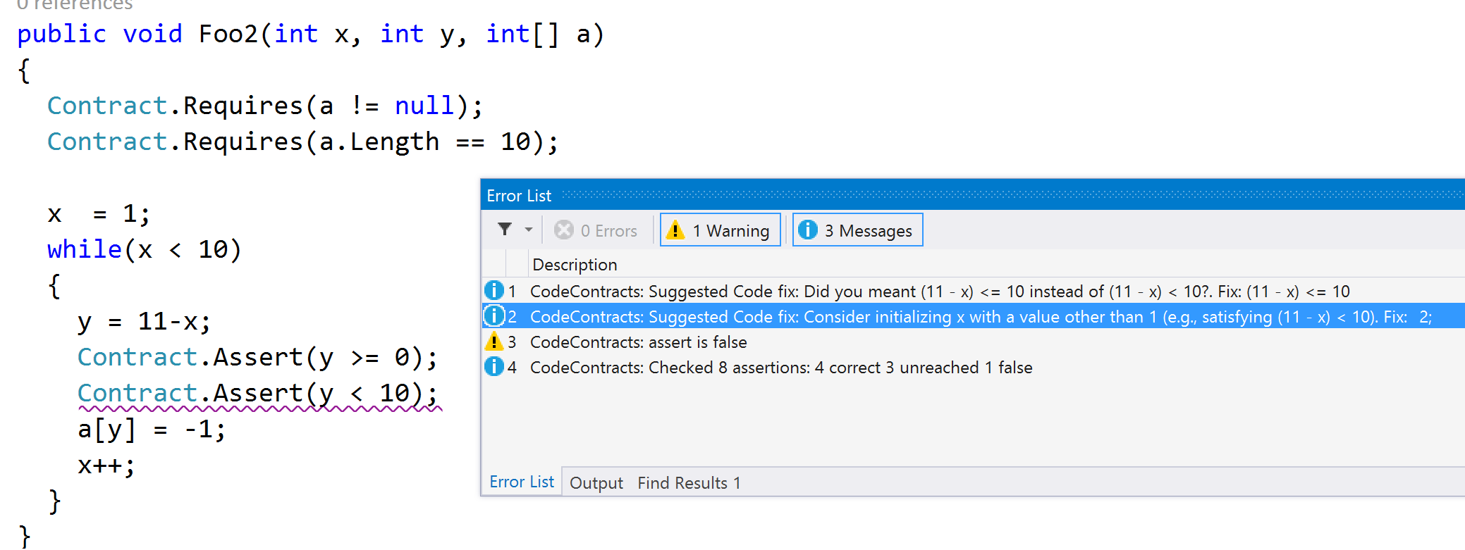
Refactoring that fixes your code
F. Logozzo, T. Ball,
Modular and verified code repairs, OOPSLA’12

Slide 14
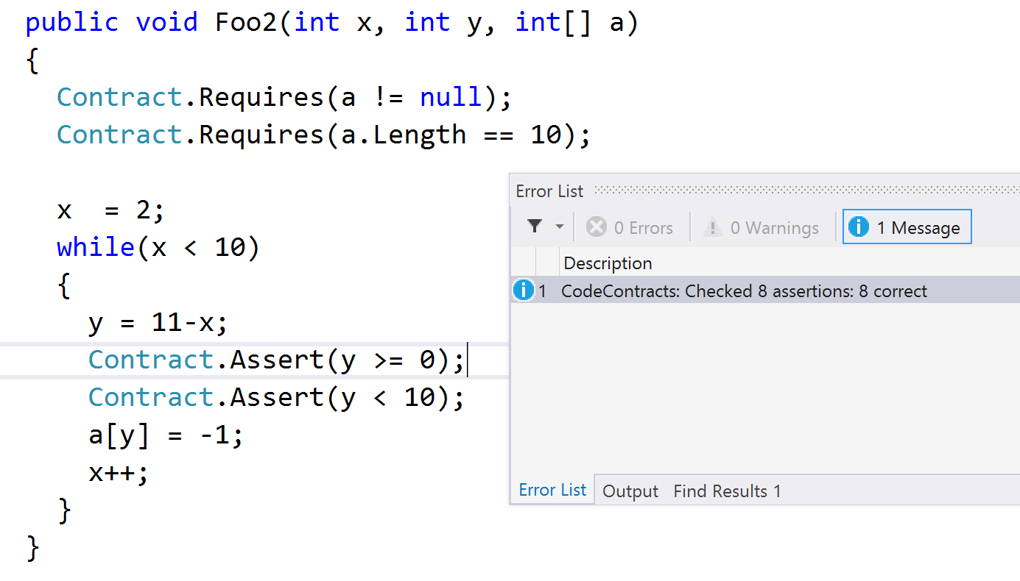
With the refactoring applied

Slide 15
Other refactorings…
Overflowing expressions
Floating point expressions
Tests
Initializations
…

Slide 16
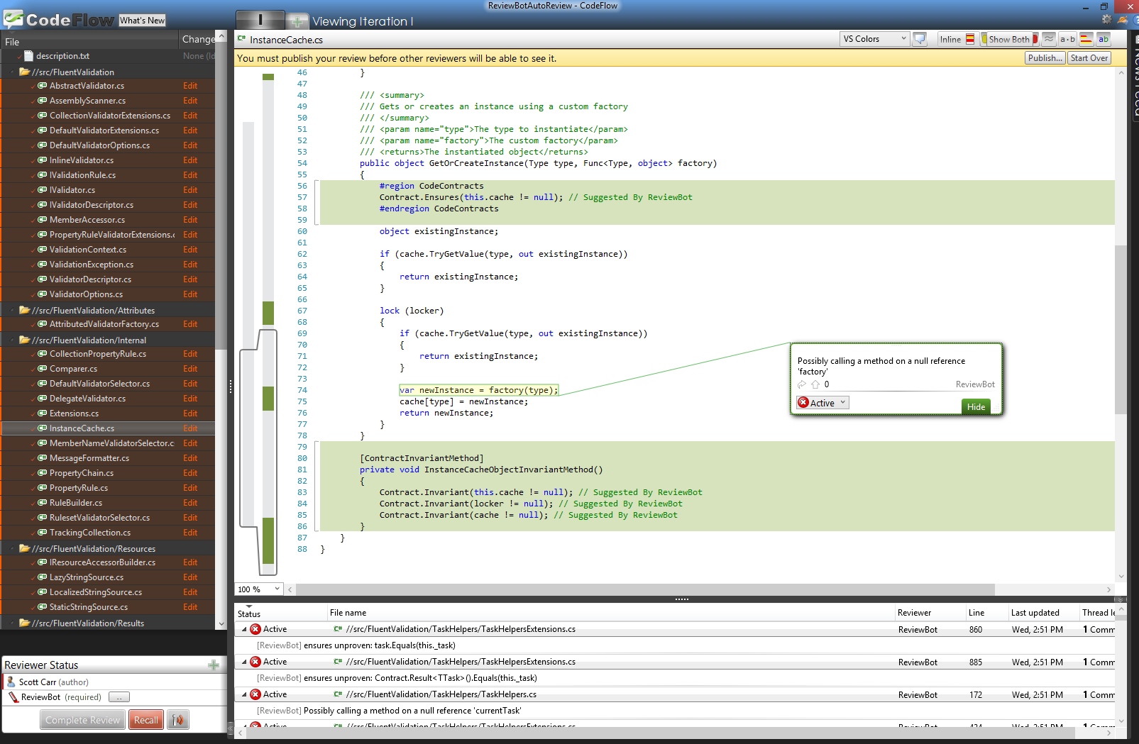
Automatic refactoring for contracts
Inserted contracts are sound, i.e., do not restraint the semantics

Slide 17
To sum up…
I found myself doing refactoring
Proof-improving refactoring
Can prove more than before refactoring
Examples
Extract methods with contracts
Refactorings to repair
Automatic program instrumentation

